Slide 1

PROGRAMMING FUNDAMENTALS
FALL 2023

Slide 2


WEEK 9
Nesting of LOOPS

Slide 3
Quiz 3 was taken

Slide 4
For loop within for loop

Slide 5
Write output
int outer ,inner;
for(outer=0;outer<3;outer++)
{
for(inner=0;inner<3;inner++)
{
printf("outer is %d and inner is %d \n",outer,inner);
}
printf(" \n");
}

Slide 6
Write code for this
1
12
123
1234
12345

Slide 7
Write code for this
12345
12345
12345
12345
12345

Slide 8
WEEK 8(LEC 16)

Slide 9
Write code
******
*****
****
***
**
*

Slide 10
int outerLoop = 1;
int innerLoop = 4;
do {
printf("Outer Loop: %d\n", outerLoop);
do {
printf("Inner Loop: %d\n", innerLoop);
innerLoop--;
} while (innerLoop > 0);
innerLoop = 4; // Reset inner loop counter
outerLoop--;
} while (outerLoop > 0);

Slide 11
Try on while loop

Slide 12
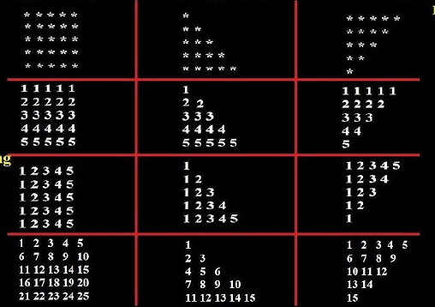

Slide 13

Name :_____
Quiz :_____
Bring A4 pages in every class from now onward , we can have quiz /quizzes any time.
If quizzes are attempted on any other page than A4 white page , direct zero will be awarded.

Slide 14
THANK YOU
Allah says in Surah Luqman (interpretation of the meaning):
“And of mankind is he who purchases idle talks (i.e. music, singing) to mislead (men) from the path of Allah…” [Luqman 31:6]
The scholar of the ummah, Ibn 'Abbas (may Allah be pleased with him) said: this means singing . Mujahid (may Allah have mercy on him) said: this means playing the drum (tabl). (Tafsir al-Tabari, 21/40)
Al-Hasan al-Basri (may Allah have mercy on him) said: this ayah was revealed concerning singing and musical instruments (lit. woodwind instruments). (Tafsir Ibn Kathir, 3/451)

